Slide 1
Welcome!
CEL Kids Hackathon
Prep Session for Scratch
Notes:
Good After noon!
Five years ago, Afroz a grade 3 student asked me how does a computer work. After our discussion, I started researching about the computer curriculum and was surprised to see that kids only learn about hardware and office application which makes them conversant with computer.

Slide 2
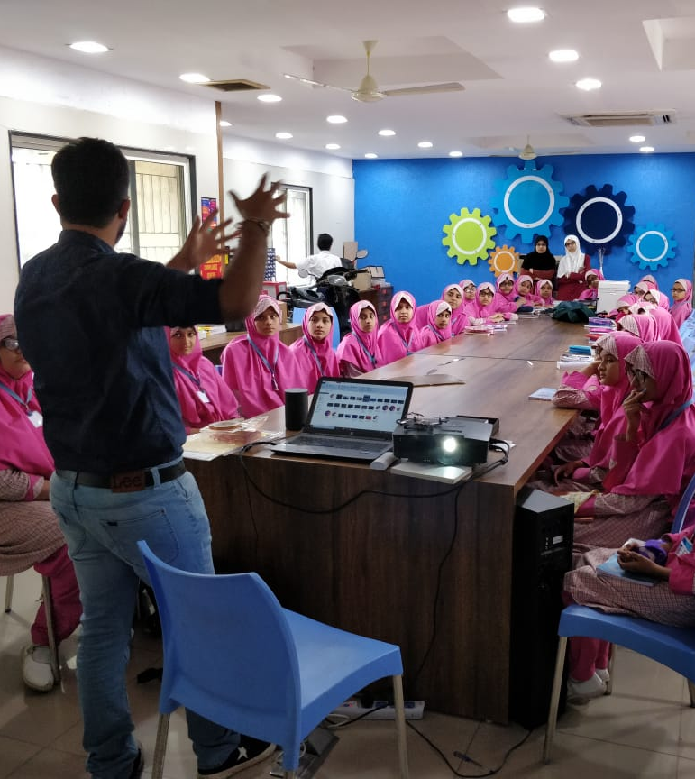
Code To Enhance Learning
Code to Enhance Learning is nonprofit uses coding as a tool to build critical thinking, creativity, collaboration and perseverance in children in grade 4-9.
Notes:
Good After noon!
Five years ago, Afroz a grade 3 student asked me how does a computer work. After our discussion, I started researching about the computer curriculum and was surprised to see that kids only learn about hardware and office application which makes them conversant with computer.

Slide 3
CEL Kids Hackathon
Code to Enhance Learning
CEL Kids Hackathon is an annual opportunity for kids in grade 5-9 to begin their coding journey and showcase their coding talent by solving contextual problems aligned to UN Sustainable Development Goals.
1
2
3
Watch learning videos about coding concept and other skills
Online Volunteers
Support
Students Register
4
5
6
Student code on phone or computer on problem statement aligned to SDGs
Certificate with Personalized Feedback for all & Prize Money for Winners
Expert Evaluation
Notes:
Our solution is

Slide 4
Lesson 1
My Sprite Speaks

Slide 5
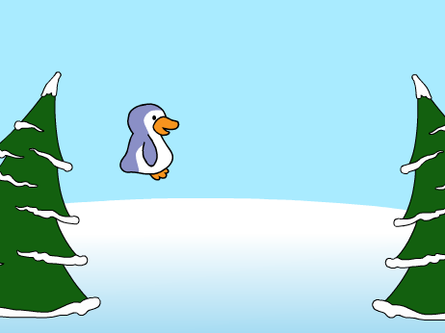
Objective:
We will make a sprite move left, right, up and down when the arrow keys are pressed by playing a sound.
Let’s look at the project
Notes:
Purpose:
Introduction
Connections
Benefits of the process

Slide 6
Program:
I will tell computer and it will follow me. Let’s see what happens?
Computer! Switch off!
Computer! Play a song!
So, today we will learn to write programs!
Thinking Questions:
Why do you think that computer is not following our instructions?
The instructions that a computer can understand to complete a given task is called Program. Program is also called a Code or a Script.
Notes:
Purpose:
Introduction
Connections
Benefits of the process

Slide 7
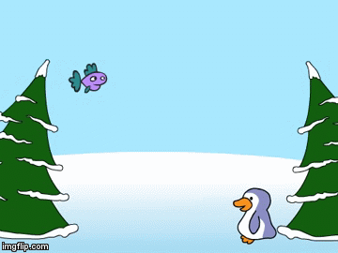
Scratch:
What is Scratch?
Scratch is a computer block based programming language.
What is Scratch used for?
Scratch is used to make games, animations and applications.
Why should we learn to write programs?
It helps to think, to be creative and builds other relevant skills.
It is one of the important skill in the current digital world.
Notes:
Purpose:
Introduction
Connections
Benefits of the process

Slide 8
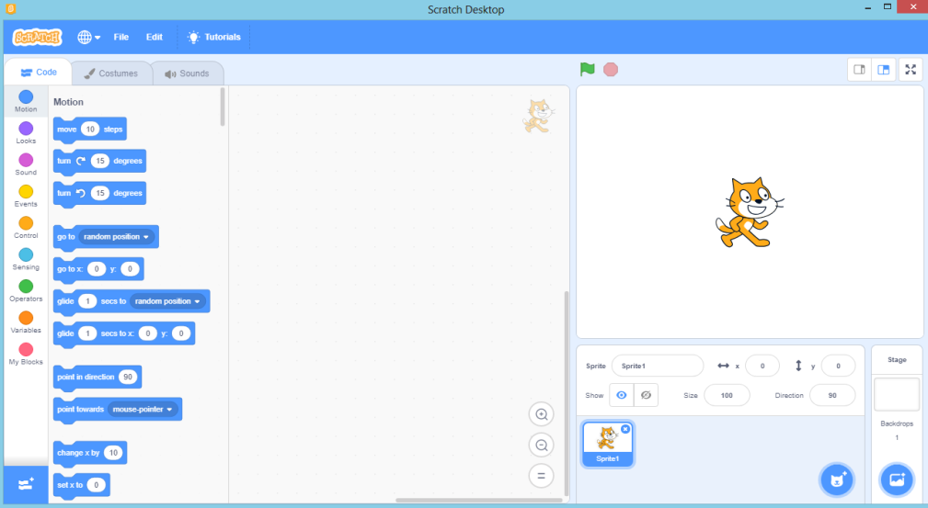
Components of Scratch:
The important components of Scratch are,
Stage
Block Box/Palette
Editor
Stage
Editor
Block Box
Notes:
Purpose:
Introduction
Connections
Benefits of the process

Slide 9
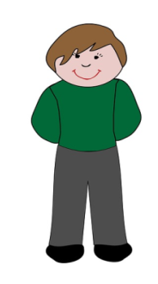
Sequence
Sequence means in proper logical order.
A boy and a girl
Talk to your partner:
Think of one example of sequence.
Let’s share the response.

Slide 10
My Sprite Speaks: (Teacher Models)
Let’s do abstraction to make understand project and make it simple
1) What will happen on the stage?
Penguin will move right and say I am moving right
Penguin will move left and say I am moving left
Penguin will move up and say I am moving up
Penguin will move down and say I am moving down.
2) What sprite and backdrop will be needed on the stage?
Sprite Penguin
Backdrop winter
Notes:
Purpose:
Introduction
Connections
Benefits of the process

Slide 11
My Sprite Speaks: (Teacher Models)
Let’s make the project and write codes for the sprites…
Notes:
Purpose:
Introduction
Connections
Benefits of the process

Slide 12
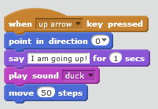
Quiz:
Answer in the Chat box:
What will happen if we give the below mentioned instructions to a Sprite?
Let’s share.
Notes:
Purpose:
Introduction
Connections
Benefits of the process

Slide 13
Quiz:
Talk to your partner:
The sprite has to play pop sound, then say “I am happy!” for 2 seconds and then play “Ya” sound. Which of the following is the correct program?
A) B) C) D)
Let’s share the correct option.
Notes:
Purpose:
Introduction
Connections
Benefits of the process

Slide 14
Closing:
What did we do today?
What is one thing that you liked in the class the most?
What did you learn?
Notes:
Purpose:
Introduction
Connections
Benefits of the process

Slide 15
Code to Enhance Learning
Timelines to Remember
Virtual Support Starts
19 Dec 21
Submission of deliverables by 6:00 pm 7 Feb
Felicitation Event
28 March 2021
Hackathon Week
Starts 1 Feb
Participants receive problem statement
Registration Starts
23 Nov
Registration Ends
15 Jan 2021
Result
14 March 2021
Participants prepare after registering using CEL resources and through virtual support.

Slide 16
Code to Enhance Learning
Code To Enhance Learning
Website: www.codetoenhancelearning.org

