Slide 1
Welcome!
CEL Kids Hackathon
Prep Session for Scratch

Slide 2
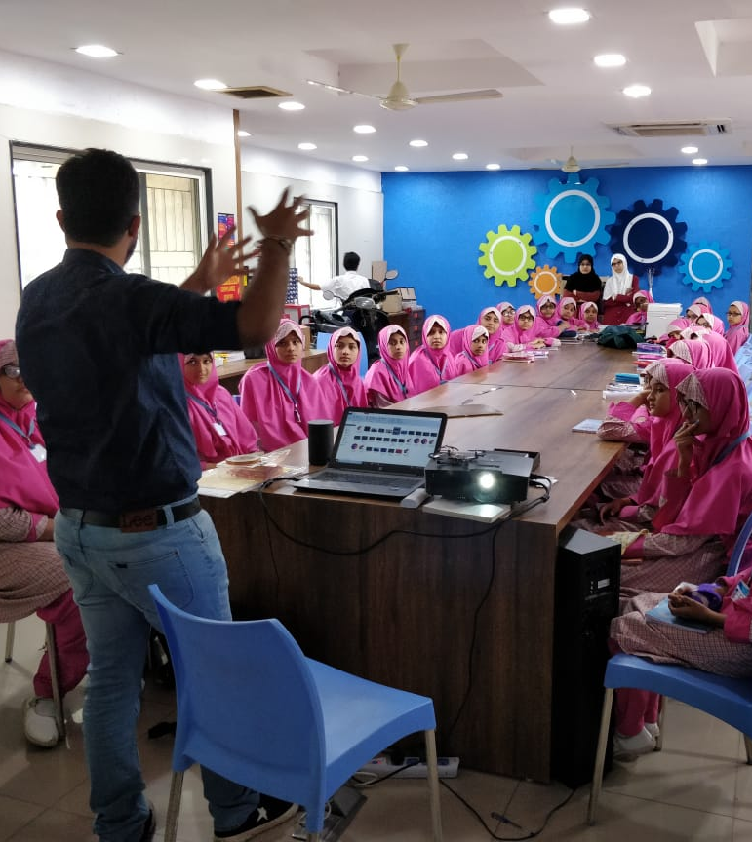
Code To Enhance Learning
Code to Enhance Learning is nonprofit uses coding as a tool to build critical thinking, creativity, collaboration and perseverance in children in grade 5-9.

Slide 3
CEL Kids Hackathon
CEL Kids Hackathon is an annual opportunity for kids in grade 5-9 to begin their coding journey and showcase their coding talent by solving contextual problems aligned to UN Sustainable Development Goals.
1
2
3
Watch learning videos about coding concept and other skills
Online Volunteers
Support
Students Register
4
5
6
Student code on phone or computer on problem statement aligned to SDGs
Certificate with Personalized Feedback for all & Prize Money for Winners
Expert Evaluation

Slide 4
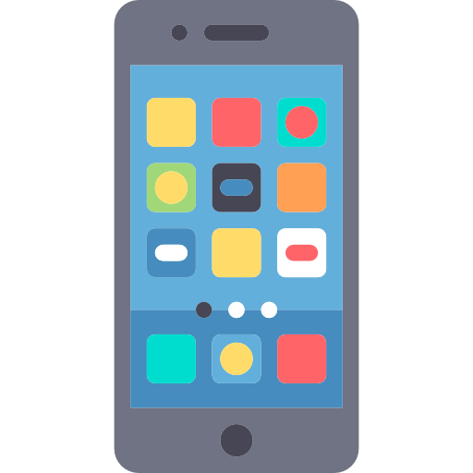
How will I make Project for Hackathon?
Phone using Pocket Code
Pocket code allows you to code on smartphone
Session on Pocket Code:
4-5 pm on Saturday & Sunday
Laptop/desktop with Scratch
Scratch allows you to code on Desktop/Laptop
Session on Scratch:
6-7 pm on Saturday & Sunday

Slide 5
Keep your audio on mute when you are not speaking
Norms
Use chat box to ask question/comment/appreciate
Chat
Take notes

Slide 6
Lesson 10
Quiz

Slide 7
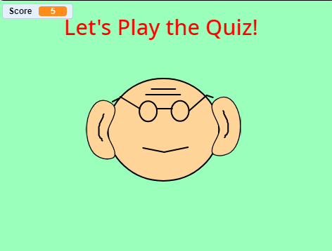
Objective:
We will make an application where the user have to answer some quiz questions.
Let’s look at the project

Slide 8
Let’s Recall:
1. What is Sequence?
A logical Order
2. What is Events?
An event in an action due to which something happens.
3. What is Loop?
Repeats a sequence of instructions
4. What is Nested Loop?
Loop within a Loop.
5. What is Conditionals?
Conditionals are expressions that evaluate to either true or false.
6. What is Parallelism?
The ability of the brain to do many things (aka, processes) at once

Slide 9
Let’s Recall:
7. What is Broadcasting?
Instructions are transmitted from a sprite or backdrop to cause other things to happen.
8. What are Operators?
Operators are a part of an expression and allows us to operate on values i.e. operands. The expression returns a value.
9. What is Variable?
Variables are used to store information to be referenced and manipulated in a computer program.
10. What is List?
List variables, can store multiple data at the same time. Each value stored in the List has a specific place in the list. You can also alter the value stored in the List and even manipulate them.

Slide 10
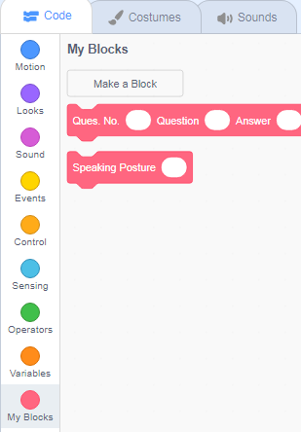
Functions
At this point in our exploration of Scratch, we have learned how to use a large number of different blocks. However when we would like to have some functionality, we can create our own blocks and use them just like some other code blocks in scratch.

Slide 11
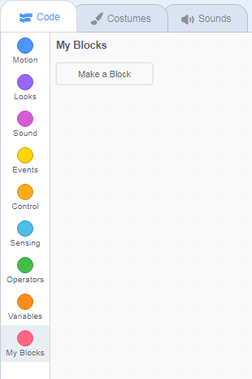
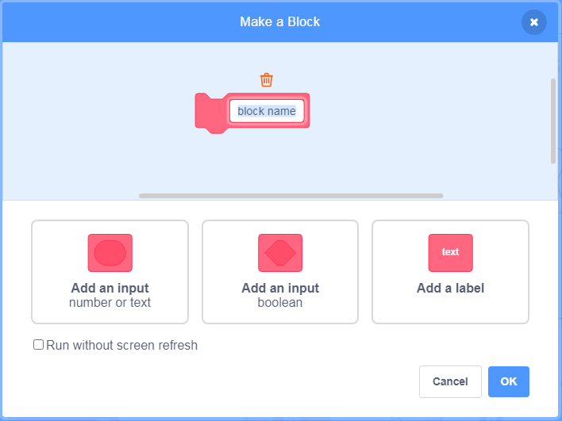
How to make your own block:
Make your own block with the combination of these three code blocks
Click on “Make a block” Option

Slide 12
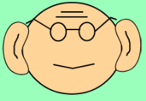
Abstraction: (Teacher Models)
Let’s do abstraction to make understand project and make it simple
1) What will happen on the stage?
The user will enter its name.
The application will ask user a question..
The user will enter the answer..
The application will check the answer input by the user. If the answer is correct, the application will tell that the answer is correct, increase the score by 1 and show the next question. If the answer is wrong then the application will tell that the answer is wrong, decrease the score by 1 and show the next question.
The application will store the score of the user at the end of the quiz.
2) What sprite and backdrop will be needed on the stage?
Sprite Pappu
Notes:
Purpose:
Introduction
Connections
Benefits of the process

Slide 13
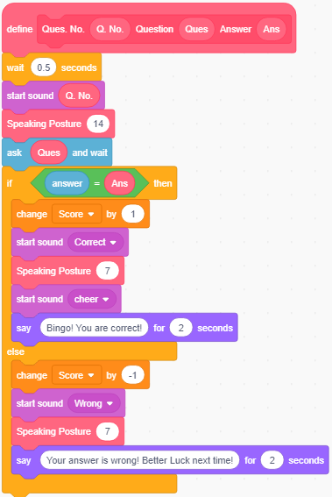
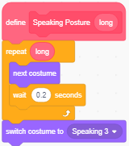
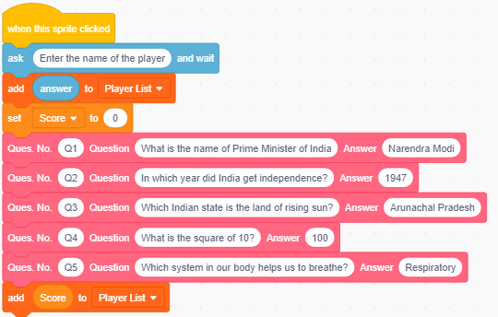
Quiz (Teacher Models)
Let’s write codes for the sprites…
Pappu
Notes:
Purpose:
Introduction
Connections
Benefits of the process

Slide 14
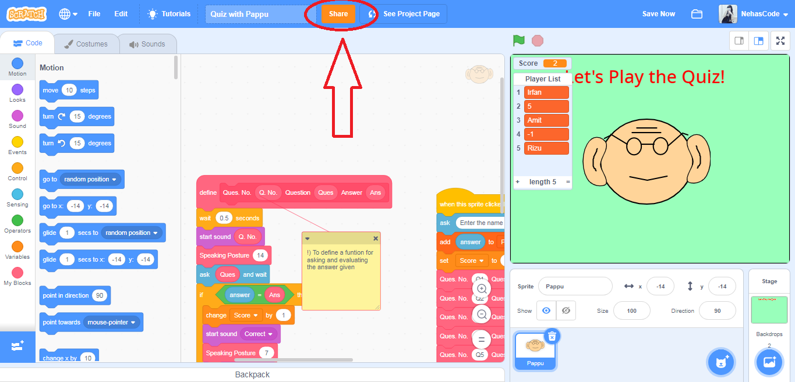
How to Share the Project:

Slide 15
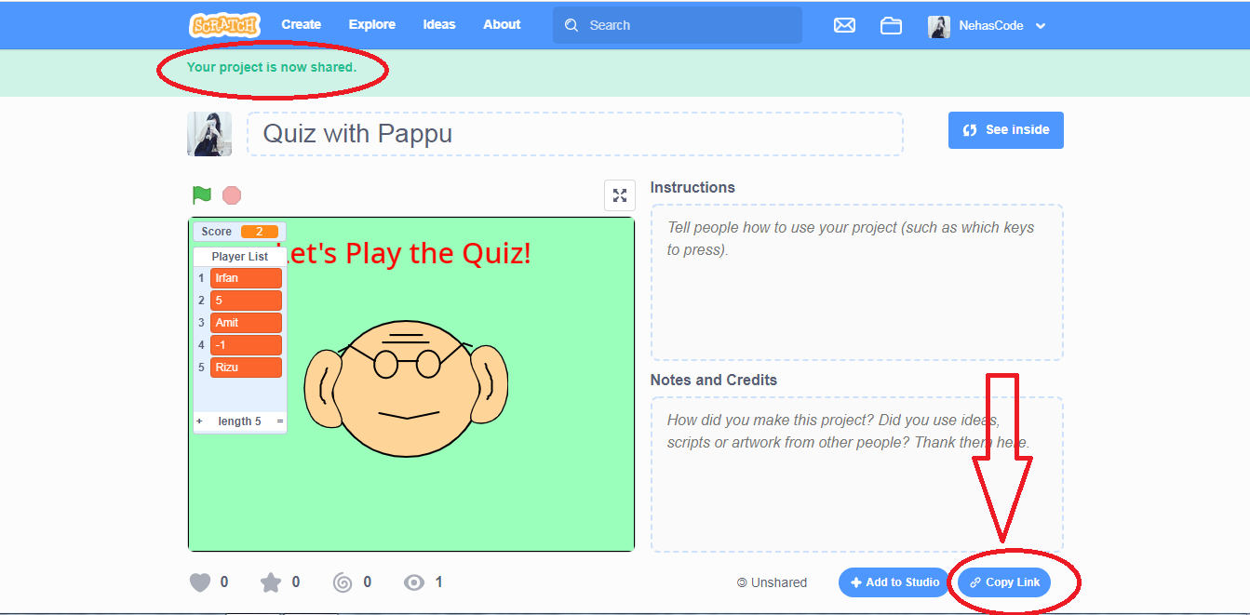
How to Share the Project:

Slide 16
Quiz 1:
1. What is Functions?

Slide 17
Quiz 2:
In a quiz application, there are certain questions asked in the application. The codes for the application are shown in the image. The codes use a Function called Question to ask question and check if the answer given by the user is correct or not. If the user answers, Narendra Modi for the first question in the quiz, what do you think will be the output of the Function?
A) “Your answer is wrong!” for 2 seconds
B) “Bingo! You are correct!” for 2 seconds
C) What is the name of Prime Minister of India
D) Narendra Modi

Slide 18
Closing:
What did we do today?
What is one thing that you liked in the class the most?
What did you learn?

Slide 19
Thank you

Slide 20
Timelines to Remember
Virtual Support Starts
19 Dec 21
Submission of deliverables by 6:00 pm 7 Feb
Felicitation Event
28 March 2021
Hackathon Week
Starts 1 Feb
Participants receive problem statement
Registration Starts
23 Nov
Registration Ends
15 Jan 2021
Result
14 March 2021
Participants prepare after registering using CEL resources and through virtual support.

Slide 21
What can you do to learn more?
1
2
3
Watch learning videos about coding concept and other skills
Watch the winners project on the website of CEL
Learn more about Sustainable Development Goals
3
Attend the next session
Notes:
Our solution is

Slide 22
Our Supporters
In collaboration with,
We are extremely grateful to our partners for making a concerted effort to encourage children in India to learn coding and showcase their coding talent to make this world a better place.
Notes:
Our solution is

Slide 23
Code To Enhance Learning
Website: www.codetoenhancelearning.org

