Slide 1
Welcome!
CEL Kids Hackathon
Prep Session for Scratch
Notes:
Good After noon!
Five years ago, Afroz a grade 3 student asked me how does a computer work. After our discussion, I started researching about the computer curriculum and was surprised to see that kids only learn about hardware and office application which makes them conversant with computer.

Slide 2
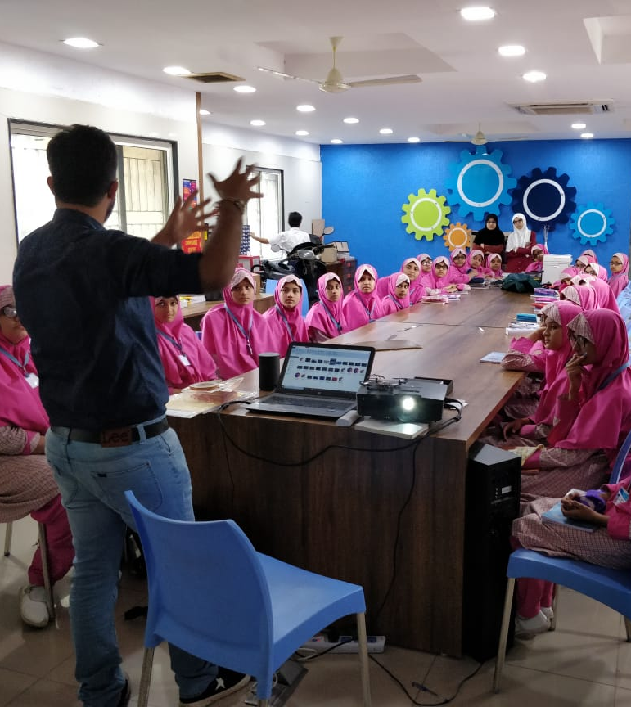
Code To Enhance Learning
Code to Enhance Learning is nonprofit uses coding as a tool to build critical thinking, creativity, collaboration and perseverance in children in grade 4-9.
Notes:
Good After noon!
Five years ago, Afroz a grade 3 student asked me how does a computer work. After our discussion, I started researching about the computer curriculum and was surprised to see that kids only learn about hardware and office application which makes them conversant with computer.

Slide 3
CEL Kids Hackathon
Code to Enhance Learning
CEL Kids Hackathon is an annual opportunity for kids in grade 5-9 to begin their coding journey and showcase their coding talent by solving contextual problems aligned to UN Sustainable Development Goals.
1
2
3
Watch learning videos about coding concept and other skills
Online Volunteers
Support
Students Register
4
5
6
Student code on phone or computer on problem statement aligned to SDGs
Certificate with Personalized Feedback for all & Prize Money for Winners
Expert Evaluation
Notes:
Our solution is

Slide 4
Lesson 2
Colorful Shapes

Slide 5
Objective:
We will be able to create different geometrical shapes. (Line, rectangle, square, circle, parallelogram, trapezium, polygon)
Let’s look at the project!

Slide 6
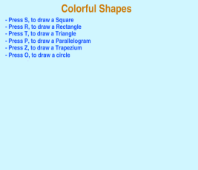
Colorful Shapes: (Teacher Models)
Let’s do abstraction to make understand project and make it simple
What will happen on the stage?
Shows instructions to draw square, rectangle or triangle
Draws square, rectangle or triangle
2) What sprite and backdrop will be needed on the stage?
Turtle Sprite
Backdrop with instructions to draw shapes
Notes:
Purpose:
Introduction
Connections
Benefits of the process

Slide 7
Events
In modern applications, making it interactive is important to keep the users engage. For example, when you click on your phone the application starts, swiping a screen to change the content, etc.
Such actions tells computer what it is supposed to do and are called Events. Events are defined as an action which causes other things to happen.
Talk to your partner:
Where have you seen events in real life?
Let’s share the response.
Notes:
Purpose:
Introduction
Connections
Benefits of the process

Slide 8
Colorful Shapes : (Teacher Models)
Let’s write codes for the sprites and make the project…
Notes:
Purpose:
Introduction
Connections
Benefits of the process

Slide 9
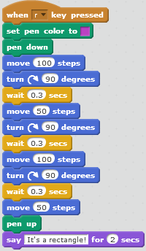
Quiz:
Talk to your partner:
How do you think the code shown in the image will run?
Let’s share.
Notes:
Purpose:
Introduction
Connections
Benefits of the process

Slide 10
Quiz:
Talk to your partner:
On stage there is a sprite to draw different shapes. You are supposed to write programs for the sprite to draw a line, a square and a rectangle. What is the most preferred event you will choose from the ones given below for the program to draw a line?
A) B)
C) D)
Let’s share the correct option.
Notes:
Purpose:
Introduction
Connections
Benefits of the process

Slide 11
Closing:
What did we do today?
What is one thing that you liked in the class the most?
What did you learn?
Notes:
Purpose:
Introduction
Connections
Benefits of the process

Slide 12
Thank you

Slide 13
Code to Enhance Learning
Timelines to Remember
Virtual Support Starts
19 Dec 21
Submission of deliverables by 6:00 pm 7 Feb
Felicitation Event
28 March 2021
Hackathon Week
Starts 1 Feb
Participants receive problem statement
Registration Starts
23 Nov
Registration Ends
15 Jan 2021
Result
14 March 2021
Participants prepare after registering using CEL resources and through virtual support.

Slide 14
Code to Enhance Learning
Code To Enhance Learning
Website: www.codetoenhancelearning.org

