Slide 1
Welcome!
CEL Kids Hackathon
Prep Session for Scratch
Notes:
Good After noon!
Five years ago, Afroz a grade 3 student asked me how does a computer work. After our discussion, I started researching about the computer curriculum and was surprised to see that kids only learn about hardware and office application which makes them conversant with computer.

Slide 2
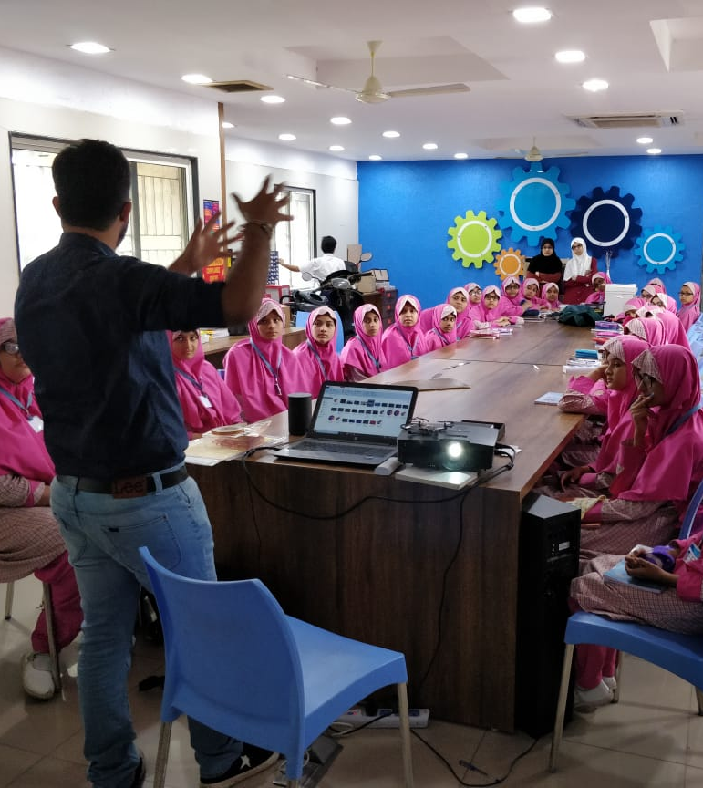
Code To Enhance Learning
Code to Enhance Learning is nonprofit uses coding as a tool to build critical thinking, creativity, collaboration and perseverance in children in grade 4-9.
Notes:
Good After noon!
Five years ago, Afroz a grade 3 student asked me how does a computer work. After our discussion, I started researching about the computer curriculum and was surprised to see that kids only learn about hardware and office application which makes them conversant with computer.

Slide 3
CEL Kids Hackathon
Code to Enhance Learning
CEL Kids Hackathon is an annual opportunity for kids in grade 5-9 to begin their coding journey and showcase their coding talent by solving contextual problems aligned to UN Sustainable Development Goals.
1
2
3
Watch learning videos about coding concept and other skills
Online Volunteers
Support
Students Register
4
5
6
Student code on phone or computer on problem statement aligned to SDGs
Certificate with Personalized Feedback for all & Prize Money for Winners
Expert Evaluation
Notes:
Our solution is

Slide 4
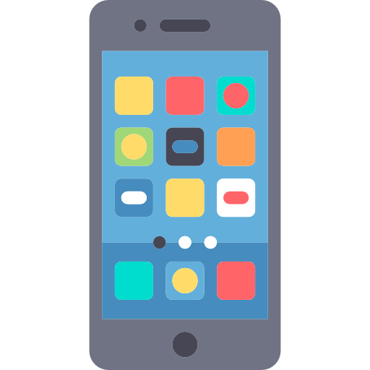
How will I make Project for Hackathon?
Code to Enhance Learning
Phone using Pocket Code
Pocket code allows you to code on smart phone
Session on Pocket Code:
4-5 pm on Saturday & Sunday
Laptop/desktop with Scratch
Pocket code allows you to code on smart phone
Session on Pocket Code:
6-7 pm on Saturday & Sunday
Notes:
Our solution is

Slide 5
Code to Enhance Learning
Keep your audio on mute when you are not speaking
Norms
Use chat box to ask question/comment/appreciate
Chat
Take notes

Slide 6
Lesson 3
My Car

Slide 7
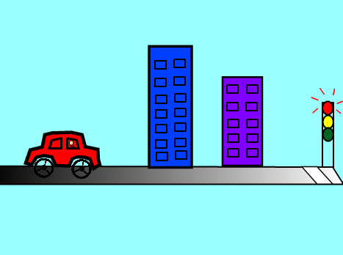
Objective:
We will make a car moving with wheels rolling on the road.
Let’s look at the project!

Slide 8
Loops
Loops means same thing happening multiple times.
Talk to your partner:
Where do you see loops in real life?
Let’s share the response.
Notes:
Purpose:
Introduction
Connections
Benefits of the process

Slide 9
My Car: (Teacher Models)
Let’s do abstraction to make understand project and make it simple
1) What will happen on the stage?
Buildings are moving back
Traffic signal is moving back
Car wheels are rolling
Car stops when brake is pressed playing braking sound
Car plays horn
Car turns on/off light
2) What sprite and backdrop will be needed on the stage?
Car Sprite
Building Sprite
Traffic Signal Sprite
Car Light Sprite
Backdrop Street
Notes:
Purpose:
Introduction
Connections
Benefits of the process

Slide 10
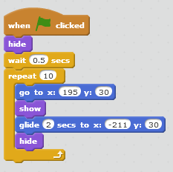
My Car: (Teacher works with kids)
Let’s write codes and make the project…
1. For the car wheels to rotate
2. For building and traffic signal to move to right to left
Notes:
Purpose:
Introduction
Connections
Benefits of the process

Slide 11
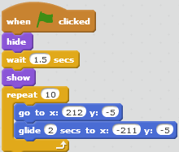
My Car: (Teacher works with kids)
Let’s write codes and make the project…
3. For lights to turn and off 4. For traffic signal to move
Notes:
Purpose:
Introduction
Connections
Benefits of the process

Slide 12
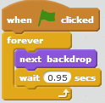
Quiz 1:
Talk to your partner:
How do you think the code shown in the image will run?
A) When green flag is clicked, the stage will change to the next costume, wait for 0.95 seconds and will keep on doing this for ever
B) When green flag is clicked, the stage will change to the next costume, wait for 0.95 seconds
C) When green flag is clicked, the stage will change to the next costume and will keep on doing this for ever
D) When green flag is clicked, the stage will change to the next costume
Let’s share.
Notes:
Purpose:
Introduction
Connections
Benefits of the process

Slide 13
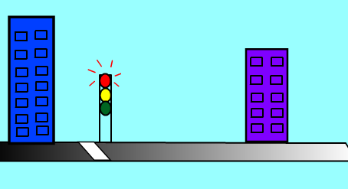
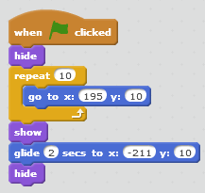
Quiz 2:
Talk to your partner:
Pooja wants to make the building move on the stage. Will the code given in the image work? Say Yes or No and Give reasons
Let’s share the response.
Code given to Pooja!
Notes:
Purpose:
Introduction
Connections
Benefits of the process

Slide 14
Closing:
What did we do today?
What is one thing that you liked in the class the most?
What did you learn?
Notes:
Purpose:
Introduction
Connections
Benefits of the process

Slide 15
Thank you

Slide 16
Code to Enhance Learning
Timelines to Remember
Virtual Support Starts
19 Dec 21
Submission of deliverables by 6:00 pm 7 Feb
Felicitation Event
28 March 2021
Hackathon Week
Starts 1 Feb
Participants receive problem statement
Registration Starts
23 Nov
Registration Ends
15 Jan 2021
Result
14 March 2021
Participants prepare after registering using CEL resources and through virtual support.

Slide 17
What can you do to learn more?
Code to Enhance Learning
1
2
3
Watch learning videos about coding concept and other skills
Watch the winners project on the website of CEL
Learn more about Sustainable Development Goals
3
Attend the next session
Notes:
Our solution is

Slide 18
Our Supporters
Code to Enhance Learning
We are extremely grateful to our partners below for making a concerted effort to encourage children in India to learn coding and showcase their coding talent to make this world a better place,
Notes:
Our solution is

Slide 19
Code to Enhance Learning
Code To Enhance Learning
Website: www.codetoenhancelearning.org

