Slide 1
Welcome!
CEL Kids Hackathon
Prep Session for Scratch
Notes:
Good After noon!
Five years ago, Afroz a grade 3 student asked me how does a computer work. After our discussion, I started researching about the computer curriculum and was surprised to see that kids only learn about hardware and office application which makes them conversant with computer.

Slide 2
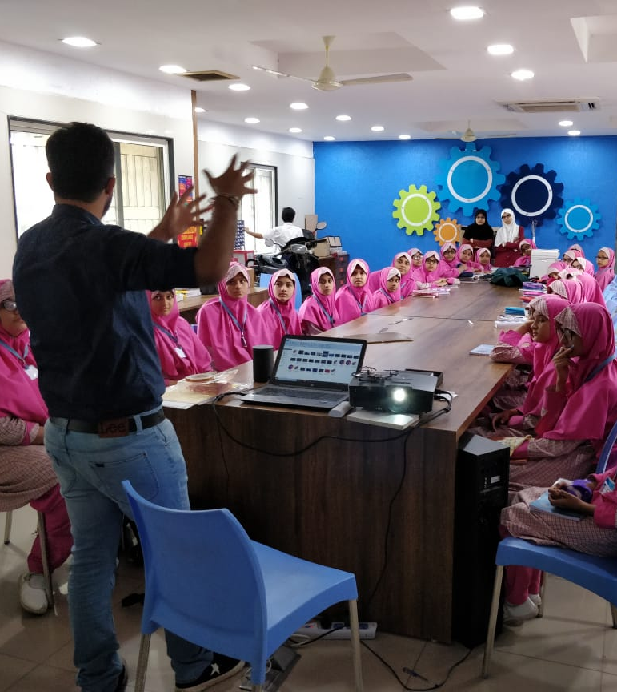
Code To Enhance Learning
Code to Enhance Learning is nonprofit uses coding as a tool to build critical thinking, creativity, collaboration and perseverance in children in grade 4-9.
Notes:
Good After noon!
Five years ago, Afroz a grade 3 student asked me how does a computer work. After our discussion, I started researching about the computer curriculum and was surprised to see that kids only learn about hardware and office application which makes them conversant with computer.

Slide 3
CEL Kids Hackathon
Code to Enhance Learning
CEL Kids Hackathon is an annual opportunity for kids in grade 5-9 to begin their coding journey and showcase their coding talent by solving contextual problems aligned to UN Sustainable Development Goals.
1
2
3
Watch learning videos about coding concept and other skills
Online Volunteers
Support
Students Register
4
5
6
Student code on phone or computer on problem statement aligned to SDGs
Certificate with Personalized Feedback for all & Prize Money for Winners
Expert Evaluation
Notes:
Our solution is

Slide 4
How will I make Project for Hackathon?
Code to Enhance Learning
Phone using Pocket Code
Pocket code allows you to code on smart phone
Session on Pocket Code:
4-5 pm on Saturday & Sunday
Laptop/desktop with Scratch
Pocket code allows you to code on smart phone
Session on Pocket Code:
6-7 pm on Saturday & Sunday
Notes:
Our solution is

Slide 5
Code to Enhance Learning
Keep your audio on mute when you are not speaking
Norms
Use chat box to ask question/comment/appreciate
Chat
Take notes

Slide 6
Lesson 4
Colorful Patterns

Slide 7
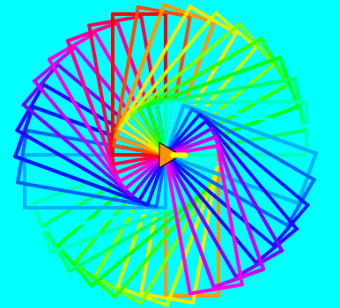
Objective:
Students will make colorful patterns with different geometrical shapes.
Let’s look at the project!

Slide 8
Nested Loop:
Nested Loop means loop present with in a loop.
This is a Loop.
Tap slow on bench x 3
This is a Nested Loop.
x 3
Tap fast on bench
This is a Loop.
Notes:
Purpose:
Introduction
Connections
Benefits of the process

Slide 9
Colorful Patterns: (Teacher Models)
Let’s do abstraction to make understand project and make it simple
What will happen on the stage?
User selects the pattern from the different patterns reading instructions on the stage
User creates the event to draw the pattern made with geometrical shapes
2) What sprite and backdrop will be needed on the stage?
Sprite Turtle
Backdrop with instructions
Notes:
Purpose:
Introduction
Connections
Benefits of the process

Slide 10
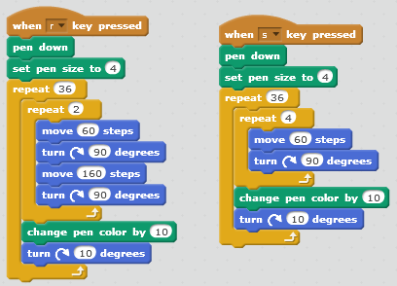
Colorful Patterns: (Teacher Models)
Let’s write codes and make the project…
Notes:
Purpose:
Introduction
Connections
Benefits of the process

Slide 11
Quiz 1:
Talk to your partner:
1. What will happen with block ?
A) sprite will say X is 0 and Y is 0
B) sprite will go in the center of the stage
C) sprite will go at the bottom of the stage
D) sprite will go at the top of the stage
Let’s share.
Notes:
Purpose:
Introduction
Connections
Benefits of the process

Slide 12
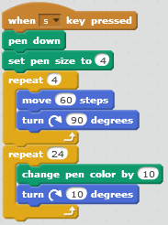
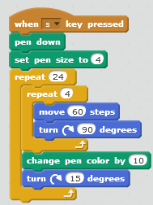
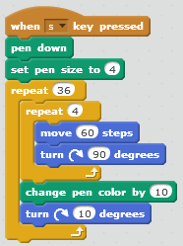
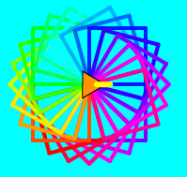
Quiz 2:
Talk to your partner:
We want to make a project where when a key is pressed on the keyboard the sprite makes squares one after the another at 10 degrees with vertex fixed as shown in the image.
Which of the program given below is correct?
10 degrees
Option A
Option B
Option C
Let’s share the response.
Notes:
Purpose:
Introduction
Connections
Benefits of the process

Slide 13
Closing:
What did we do today?
What is one thing that you liked in the class the most?
What did you learn?
Notes:
Purpose:
Introduction
Connections
Benefits of the process

Slide 14
Thank you

Slide 15
Code to Enhance Learning
Timelines to Remember
Virtual Support Starts
19 Dec 21
Submission of deliverables by 6:00 pm 7 Feb
Felicitation Event
28 March 2021
Hackathon Week
Starts 1 Feb
Participants receive problem statement
Registration Starts
23 Nov
Registration Ends
15 Jan 2021
Result
14 March 2021
Participants prepare after registering using CEL resources and through virtual support.

Slide 16
What can you do to learn more?
Code to Enhance Learning
1
2
3
Watch learning videos about coding concept and other skills
Watch the winners project on the website of CEL
Learn more about Sustainable Development Goals
3
Attend the next session
Notes:
Our solution is

Slide 17
Our Supporters
Code to Enhance Learning
We are extremely grateful to our partners below for making a concerted effort to encourage children in India to learn coding and showcase their coding talent to make this world a better place,
Notes:
Our solution is

Slide 18
Code to Enhance Learning
Code To Enhance Learning
Website: www.codetoenhancelearning.org

