Slide 1
Welcome!
CEL Kids Hackathon
Prep Session for Scratch
Notes:
Good After noon!
Five years ago, Afroz a grade 3 student asked me how does a computer work. After our discussion, I started researching about the computer curriculum and was surprised to see that kids only learn about hardware and office application which makes them conversant with computer.

Slide 2
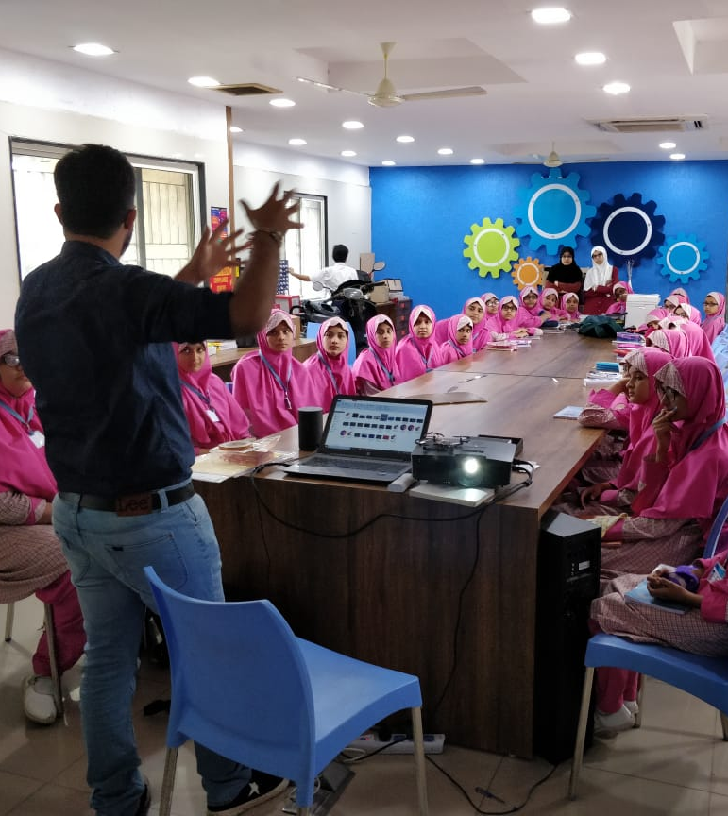
Code To Enhance Learning
Code to Enhance Learning is nonprofit uses coding as a tool to build critical thinking, creativity, collaboration and perseverance in children in grade 4-9.
Notes:
Good After noon!
Five years ago, Afroz a grade 3 student asked me how does a computer work. After our discussion, I started researching about the computer curriculum and was surprised to see that kids only learn about hardware and office application which makes them conversant with computer.

Slide 3
CEL Kids Hackathon
CEL Kids Hackathon is an annual opportunity for kids in grade 5-9 to begin their coding journey and showcase their coding talent by solving contextual problems aligned to UN Sustainable Development Goals.
1
2
3
Watch learning videos about coding concept and other skills
Online Volunteers
Support
Students Register
4
5
6
Student code on phone or computer on problem statement aligned to SDGs
Certificate with Personalized Feedback for all & Prize Money for Winners
Expert Evaluation
Notes:
Our solution is

Slide 4
How will I make Project for Hackathon?
Phone using Pocket Code
Pocket code allows you to code on smartphone
Session on Pocket Code:
4-5 pm on Saturday & Sunday
Laptop/desktop with Scratch
Scratch allows you to code on Desktop/Laptop
Session on Scratch:
6-7 pm on Saturday & Sunday
Notes:
Our solution is

Slide 5
Keep your audio on mute when you are not speaking
Norms
Use chat box to ask question/comment/appreciate
Chat
Take notes

Slide 6
Lesson 6
Make A Story

Slide 7
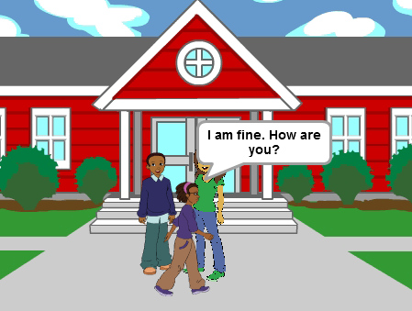
Objective:
We will make a story today.
Let’s look at the project!

Slide 8
Revision
1. What is Event?
One thing that causes other things to happen
2. What is Loop?
Same thing repeating multiple times
3. What is Nested Loop?
A loop with in a loop
4. What is conditionals?
Conditionals are expressions that evaluate to either true or false.
Notes:
Purpose:
Introduction
Connections
Benefits of the process

Slide 9
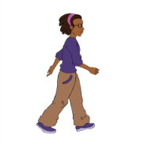
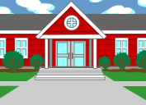
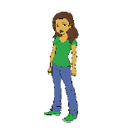
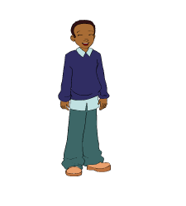
Story Telling:
Beginning
Middle
End
Introduction of the problem, introduction of solution and its implementation
Introduction of the characters and the setting
Climax with the result of the solution appears.
Notes:
Purpose:
Introduction
Connections
Benefits of the process

Slide 10
Parallelism
Parallel processing/Parallelism is the ability of the brain to do many things (aka, processes) at once.
For Example- You are doing your homework and any friend of yours calls you to chit chat. So sometimes it happens that while talking on your phone you are continuously working on your homework. Here you are working two different things at the same time.
Talk to your partner:
Any other daily life example of Parallelism?
Let’s share the response.
Notes:
Purpose:
Introduction
Connections
Benefits of the process

Slide 11
Event Broadcasting:
It is a type of event where instructions are transmitted from a sprite or backdrop to cause other things to happen.
The instructions transmitted can be received by one sprite also and by all the sprites/backdrop in parallel also.
When the instruction is received by more than one sprite in parallel then it leads to parallelism. Parallelism is many things occurring at the same time.
Notes:
Purpose:
Introduction
Connections
Benefits of the process

Slide 12
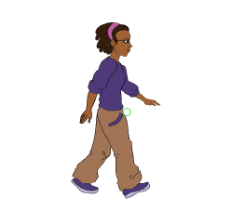
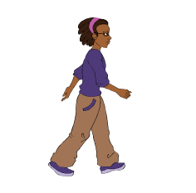
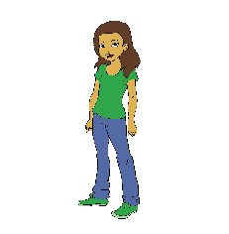
To make a story: (Teacher Models)
Let’s do abstraction to understand project and make it simple
1) What will happen on the stage?
When Scene starts, we will see a story will play out in front of us.
Your story can show a problem
At the end you can show some solution.
2) What sprite and backdrop will be needed on the stage?
Avery
Sprite 2
Sprite 3
Backdrop
Notes:
Purpose:
Introduction
Connections
Benefits of the process

Slide 13
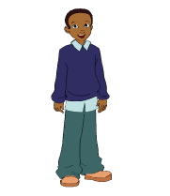
Make a Story: (Teacher Models)
Let’s bring the sprite and backdrop on the stage
Sprite
A girl with different walking costumes
A girl
A boy with laughing costumes
Backdrop
A school as Backdrop
Notes:
Purpose:
Introduction
Connections
Benefits of the process

Slide 14
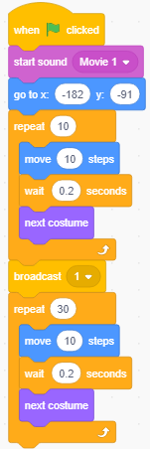
0
Make a Story: (Teacher Models)
Let’s write codes for the sprites…
A girl with different walking costumes
Notes:
Purpose:
Introduction
Connections
Benefits of the process

Slide 15
Make a Story: (Teacher Models)
Let’s write codes for the sprites…
0
0
A boy with laughing costumes
A girl
Notes:
Purpose:
Introduction
Connections
Benefits of the process

Slide 16
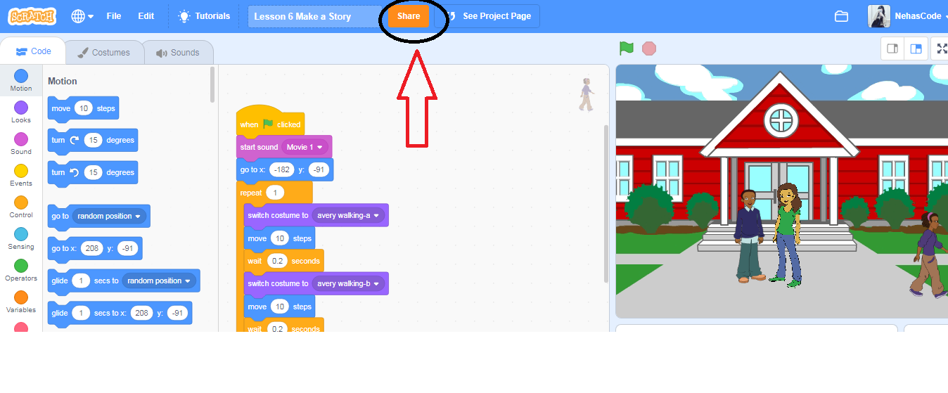
How to Share the Project:
Notes:
Purpose:
Introduction
Connections
Benefits of the process

Slide 17
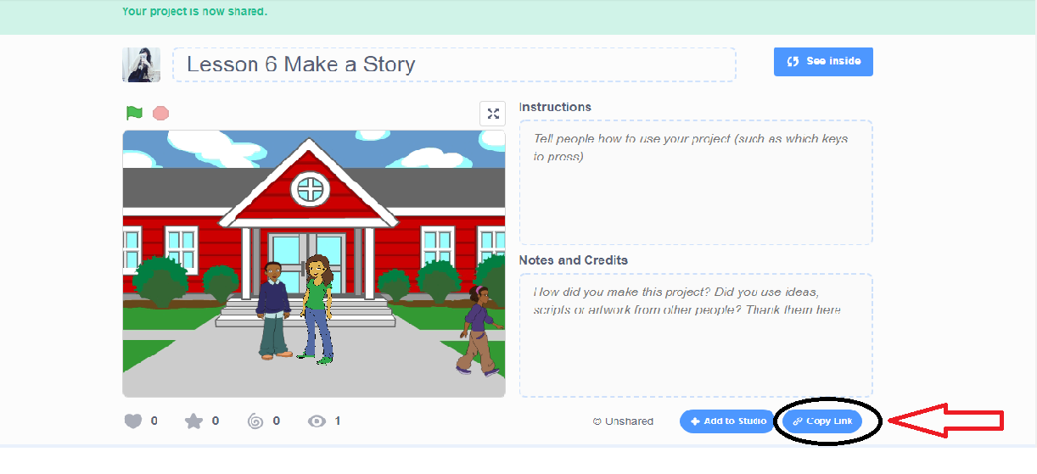
How to Share the Project:
Notes:
Purpose:
Introduction
Connections
Benefits of the process

Slide 18
Quiz 1:
Talk to your partner:
Identify which of the following program has Event Broadcasting block?
A) B)
C) D)
Notes:
Purpose:
Introduction
Connections
Benefits of the process

Slide 19
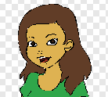
Quiz 2:
Talk to your partner:
We want to create a conversation between two sprites a boy and a girl which is as follows,
Boy: How are you?
Girl: I am fine. How are you?
Which of the following codes you will use?
B)
C) D)
Notes:
Purpose:
Introduction
Connections
Benefits of the process

Slide 20
Closing:
What did we do today?
What is one thing that you liked in the class the most?
What did you learn?
Notes:
Purpose:
Introduction
Connections
Benefits of the process

Slide 21
Thank you

Slide 22
Timelines to Remember
Virtual Support Starts
19 Dec 21
Submission of deliverables by 6:00 pm 7 Feb
Felicitation Event
28 March 2021
Hackathon Week
Starts 1 Feb
Participants receive problem statement
Registration Starts
23 Nov
Registration Ends
15 Jan 2021
Result
14 March 2021
Participants prepare after registering using CEL resources and through virtual support.

Slide 23
What can you do to learn more?
1
2
3
Watch learning videos about coding concept and other skills
Watch the winners project on the website of CEL
Learn more about Sustainable Development Goals
3
Attend the next session
Notes:
Our solution is

Slide 24
Our Supporters
In collaboration with,
We are extremely grateful to our partners for making a concerted effort to encourage children in India to learn coding and showcase their coding talent to make this world a better place.
Notes:
Our solution is

Slide 25
Code To Enhance Learning
Website: www.codetoenhancelearning.org

