Slide 1
Welcome!
CEL Kids Hackathon
Prep Session for Scratch

Slide 2
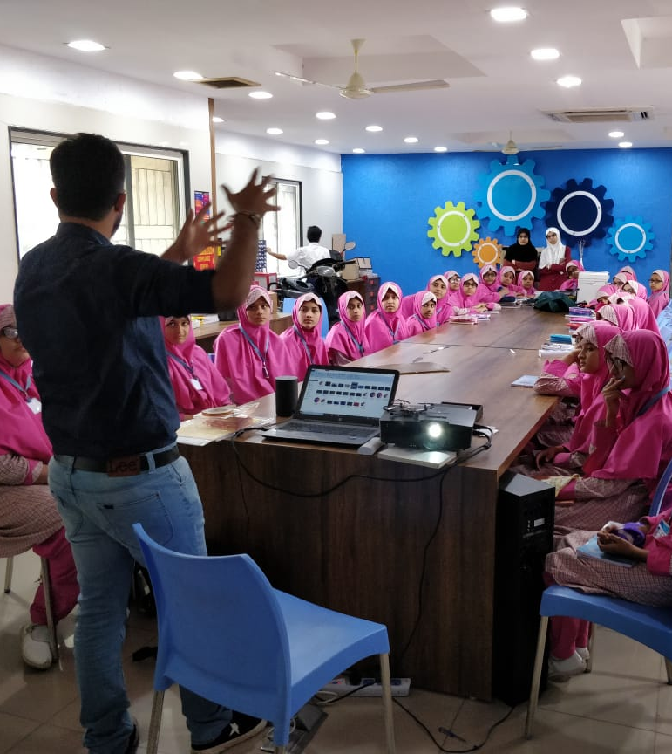
Code To Enhance Learning
Code to Enhance Learning is nonprofit uses coding as a tool to build critical thinking, creativity, collaboration and perseverance in children in grade 5-9.

Slide 3
CEL Kids Hackathon
CEL Kids Hackathon is an annual opportunity for kids in grade 5-9 to begin their coding journey and showcase their coding talent by solving contextual problems aligned to UN Sustainable Development Goals.
1
2
3
Watch learning videos about coding concept and other skills
Online Volunteers
Support
Students Register
4
5
6
Student code on phone or computer on problem statement aligned to SDGs
Certificate with Personalized Feedback for all & Prize Money for Winners
Expert Evaluation

Slide 4
How will I make Project for Hackathon?
Phone using Pocket Code
Pocket code allows you to code on smartphone
Session on Pocket Code:
4-5 pm on Saturday & Sunday
Laptop/desktop with Scratch
Scratch allows you to code on Desktop/Laptop
Session on Scratch:
6-7 pm on Saturday & Sunday

Slide 5
Keep your audio on mute when you are not speaking
Norms
Use chat box to ask question/comment/appreciate
Chat
Take notes

Slide 6
Lesson 7
Which Angle is it?

Slide 7
Objective:
We will make an application to identify the type of a given angle.
Let’s look at the project

Slide 8
Let’s Recall:
1. What is Sequence?
A logical Order
2. What is Events?
An event in an action due to which something happens.
3. What is Loop?
Repeats a sequence of instructions
4. What is Nested Loop?
Loop within a Loop.

Slide 9
Let’s Recall:
5. What is Conditionals?
Conditionals are expressions that evaluate to either true or false.
6. What is Parallelism?
The ability of the brain to do many things (aka, processes) at once
7. What is Broadcasting?
Instructions are transmitted from a sprite or backdrop to cause other things to happen.

Slide 10
Operator
Operators are a part of an expression and allows us to operate on values i.e. operands. The expression returns a value.
For example,
3 + 5 = 8
There are 4 types of operators in our scope,
Logic
Comparative
Arithmetic
String

Slide 11
Logic Operator
And is a Logic Operator which operates on expression and tells us (gives output as True) when both the expressions are True.
For example-
I like Mango And My favorite color is pink.
The output will be,
True
Or is also a Logic Operator which operates on expression and tells us (gives output as True) when any one of the expression is True.
For example-
I have one sibling Or I have 4 family members
The output will be,
True.
Not is also a Logic Operator which operates on expression and tells us (gives output as) True when the expression is incorrect.
For example-
Not My roll number is 15
The output will be,
True
The underlined sentences are called Operands.

Slide 12
Comparative Operator
Greater than (>) is a comparative operator which compares operands and tells us (gives output) as True when operand 1 is greater than operand 2.
For example-
(Operand 1) Sides of square are greater than (>) 3 (Operand 2).
The output will be,
True
Lesser than (<) is a comparative operator which compares operands and tells us (gives output) as True when operand 1 is lesser than operand 2.
For example-
Number of my sibling is lesser than (<) 5
The output will be,
False
Equal to (=) is a comparative operator which compares operands and tells us (gives output) as True when operand 1 is equal to operand 2.
For example-
My roll number is equal to (=) 1.
The output will be,
True.
The underlined sentences are called Operands.

Slide 13
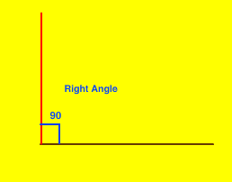
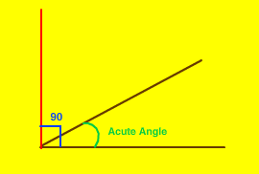
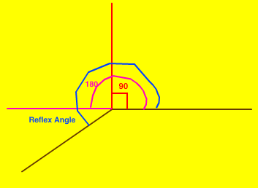
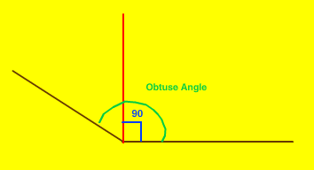
Types of Angles
Angle = 90
Right Angle
Angle > 0 and Angle < 90
Acute Angle
Angle > 180 and Angle < 360
Reflex Angle
Angle > 90 and Angle < 180
Obtuse Angle

Slide 14
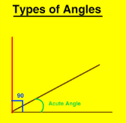
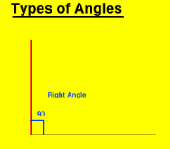
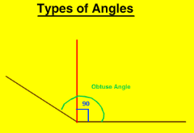
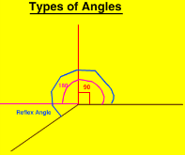
Abstraction: (Teacher Models)
Let’s do abstraction to make understand project and make it simple
1) What will happen on the stage?
Ask user to enter the degree of the angle
Application tells which type of angle is it
Application shows how does the angle looks like in the stage
2) What sprite and backdrop will be needed on the stage?
A Cat Sprite
Different types of angle on different backdrops

Slide 15
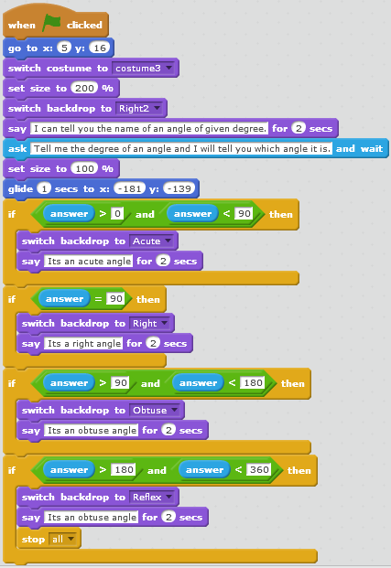
Which Angle is it? (Teacher Models)
Let’s write codes for the sprites…
Please refer the code further in the this image
A Cat Sprite
Please refer the code ahead in the next image

Slide 16
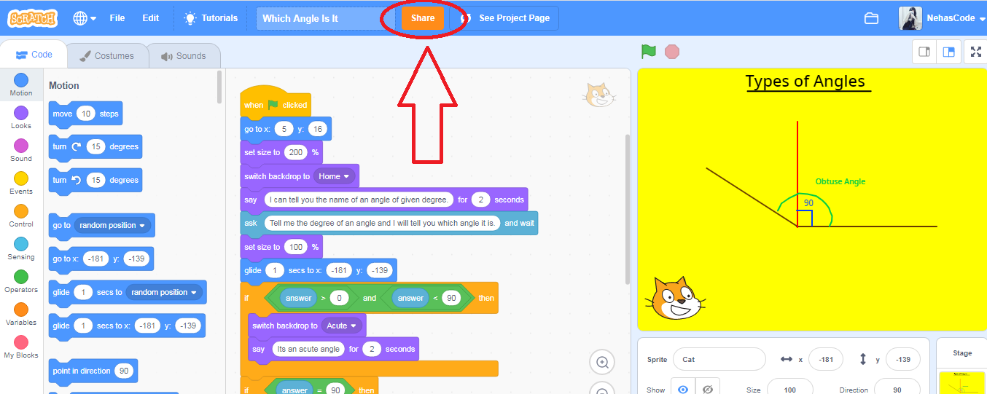
How to Share the Project:

Slide 17
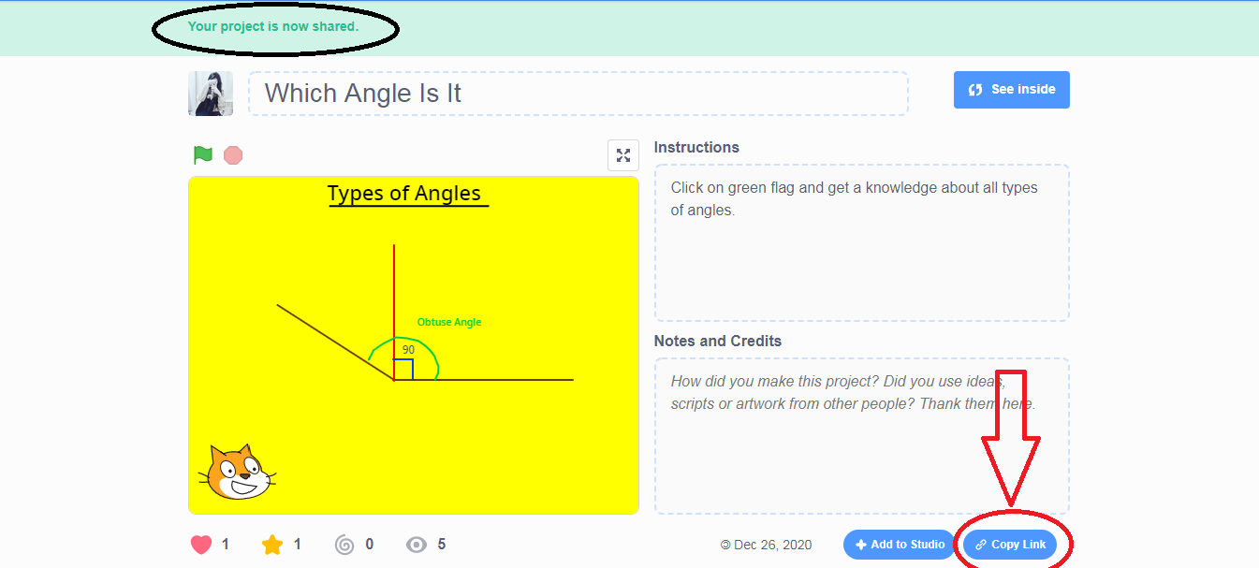
How to Share the Project:

Slide 18
Quiz 1:
1. Which operator is block?
Arithmetic Operator
B) Greater than comparative Operator
C) Logic Operator
D) Lesser than comparative operator

Slide 19
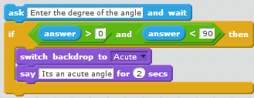
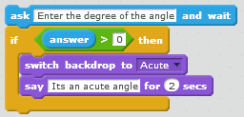
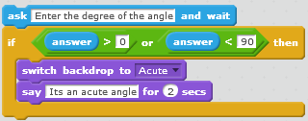
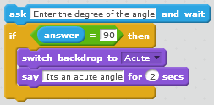
Quiz 2
Pappu wants to make an application on Scratch to find out the type of angle. The application should ask user to enter the degree of the angle. The application should check if the entered value is Acute and should tell “Its an acute angle.” if the angle is acute. Which of the following program will work?
B)
C) D)

Slide 20
Closing:
What did we do today?
What is one thing that you liked in the class the most?
What did you learn?

Slide 21
Thank you

Slide 22
Timelines to Remember
Virtual Support Starts
19 Dec 21
Submission of deliverables by 6:00 pm 7 Feb
Felicitation Event
28 March 2021
Hackathon Week
Starts 1 Feb
Participants receive problem statement
Registration Starts
23 Nov
Registration Ends
15 Jan 2021
Result
14 March 2021
Participants prepare after registering using CEL resources and through virtual support.

Slide 23
What can you do to learn more?
1
2
3
Watch learning videos about coding concept and other skills
Watch the winners project on the website of CEL
Learn more about Sustainable Development Goals
3
Attend the next session
Notes:
Our solution is

Slide 24
Our Supporters
In collaboration with,
We are extremely grateful to our partners for making a concerted effort to encourage children in India to learn coding and showcase their coding talent to make this world a better place.
Notes:
Our solution is

Slide 25
Code To Enhance Learning
Website: www.codetoenhancelearning.org

