Slide 1
Welcome!
CEL Kids Hackathon
Prep Session for Scratch

Slide 2
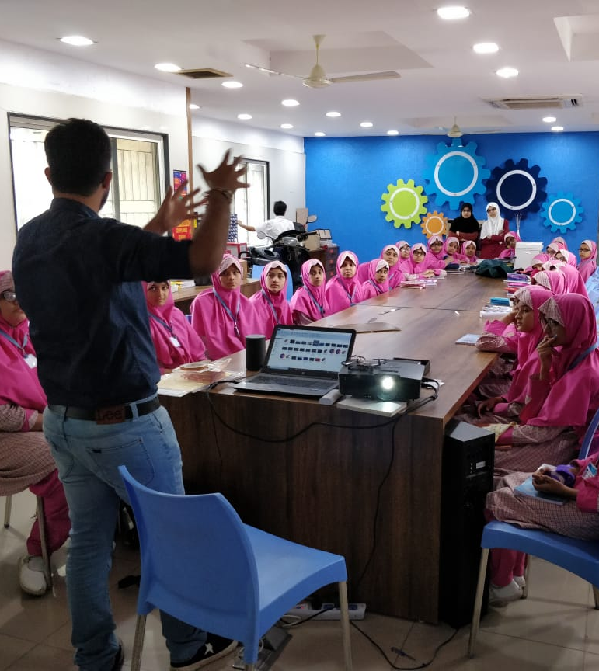
Code To Enhance Learning
Code to Enhance Learning is nonprofit uses coding as a tool to build critical thinking, creativity, collaboration and perseverance in children in grade 5-9.

Slide 3
CEL Kids Hackathon
CEL Kids Hackathon is an annual opportunity for kids in grade 5-9 to begin their coding journey and showcase their coding talent by solving contextual problems aligned to UN Sustainable Development Goals.
1
2
3
Watch learning videos about coding concept and other skills
Online Volunteers
Support
Students Register
4
5
6
Student code on phone or computer on problem statement aligned to SDGs
Certificate with Personalized Feedback for all & Prize Money for Winners
Expert Evaluation

Slide 4
How will I make Project for Hackathon?
Phone using Pocket Code
Pocket code allows you to code on smartphone
Session on Pocket Code:
4-5 pm on Saturday & Sunday
Laptop/desktop with Scratch
Scratch allows you to code on Desktop/Laptop
Session on Scratch:
6-7 pm on Saturday & Sunday

Slide 5
Keep your audio on mute when you are not speaking
Norms
Use chat box to ask question/comment/appreciate
Chat
Take notes

Slide 6
Lesson 9
E Catalogue

Slide 7
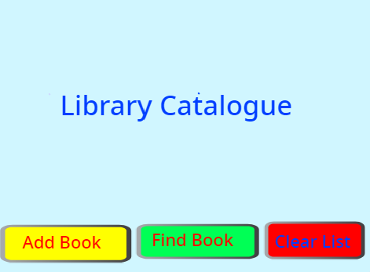
Objective:
We will make an application e-catalogue for the library.
Let’s look at the project

Slide 8
Let’s Recall:
1. What is Sequence?
A logical Order
2. What is Events?
An event in an action due to which something happens.
3. What is Loop?
Repeats a sequence of instructions
4. What is Nested Loop?
Loop within a Loop.
5. What is Conditionals?
Conditionals are expressions that evaluate to either true or false.

Slide 9
Let’s Recall:
6. What is Parallelism?
The ability of the brain to do many things (aka, processes) at once
7. What is Broadcasting?
Instructions are transmitted from a sprite or backdrop to cause other things to happen.
8. What are Operators?
Operators are a part of an expression and allows us to operate on values i.e. operands. The expression returns a value.
9. What is Variable?
Variables are used to store information to be referenced and manipulated in a computer program.

Slide 10
E Catalogue
An E-Catalogue has information like,
1) Name of the book
2) Number of the Book
3) Name of the author and many other information…
Book Name
Book Number
Q. How do you think we can store this much information and manipulate it?

Slide 11
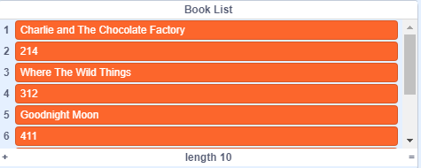
List
List, unlike variables, can store multiple data at the same time. Following is an example in Scratch of 2 Lists, Book Number and Name.
Each value stored in the List has a specific place in the list. You can also alter the value stored in the List and even manipulate them.

Slide 12
Abstraction: (Teacher Models)
Let’s do abstraction to make understand project and make it simple
What will happen on the stage?
The user can add a book in the e catalogue
The user can remove a book from e catalogue
The user can check if a specific book is available in the e catalogue and find the number serial number of the book
2) What sprite and backdrop will be needed on the stage?
Sprite Add Book Button
Sprite Find Book Button
Sprite Remove Book Button

Slide 13
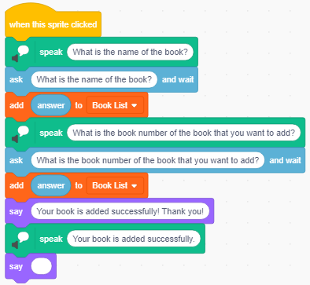
E Catalogue (Teacher Models)
Let’s write codes for the sprites…
Add Button
To add a book in the e catalogue with name and serial number

Slide 14
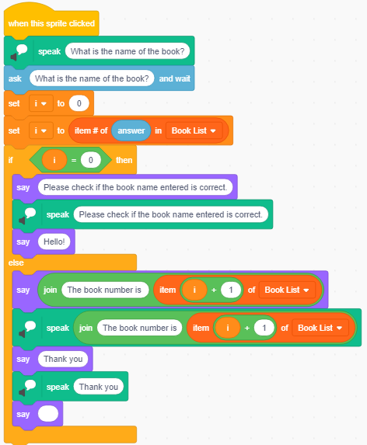
E Catalogue (Teacher Models)
Let’s write codes for the sprites…
To find a book in the e-catalogue
Find Button
To tell user that the book is not present if the name of the book entered doesn’t match the names of the books in e catalogue
To share the number of the book

Slide 15
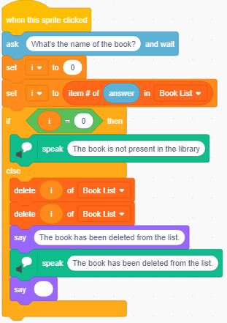
E Catalogue (Teacher Models)
Let’s write codes for the sprites…
Remove a book
To remove a book from e catalogue

Slide 16
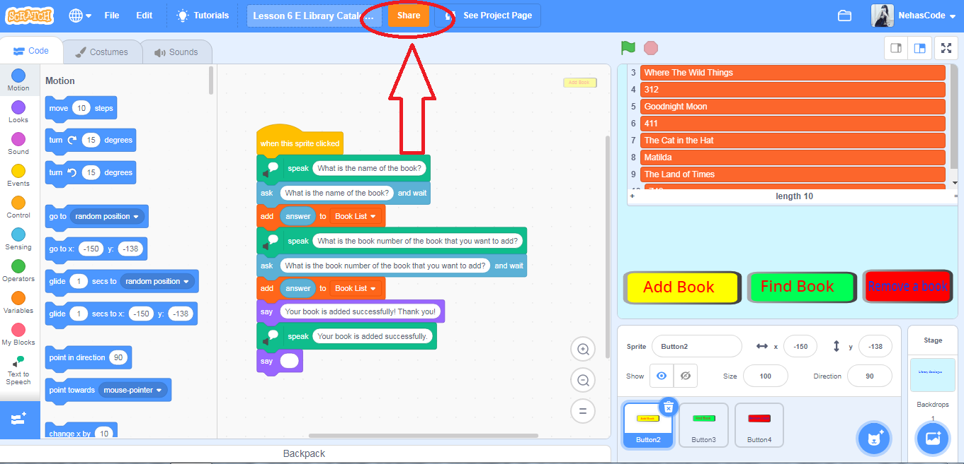
How to Share the Project:

Slide 17
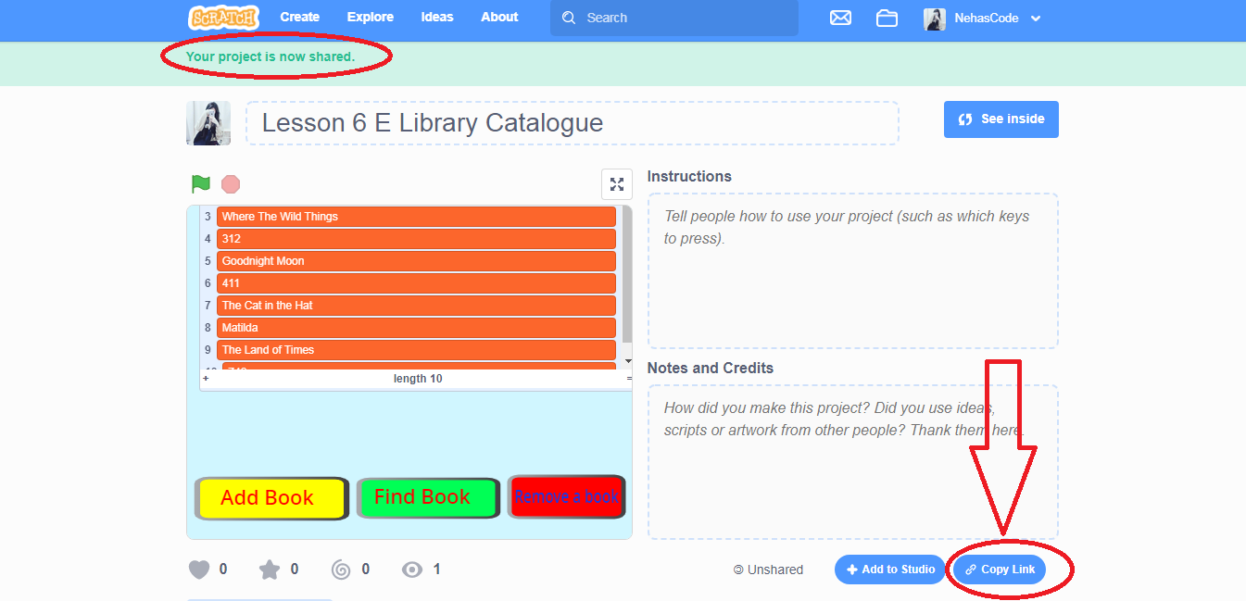
How to Share the Project:

Slide 18
Quiz 1:
1. What is List?

Slide 19
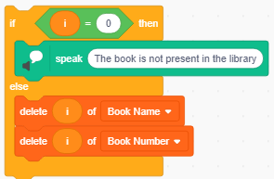
Quiz 2:
What will be the output of the program given in the image if the initial value of the variable i is 2?
A) sprite will speak “the book is not present in the library”
B) sprite will speak 2
C) the stored value at place 2 in List Book number will be removed
D) the stored value at place 2 in List Book name and List Book number will be removed

Slide 20
Closing:
What did we do today?
What is one thing that you liked in the class the most?
What did you learn?

Slide 21
Thank you

Slide 22
Timelines to Remember
Virtual Support Starts
19 Dec 21
Submission of deliverables by 6:00 pm 7 Feb
Felicitation Event
28 March 2021
Hackathon Week
Starts 1 Feb
Participants receive problem statement
Registration Starts
23 Nov
Registration Ends
15 Jan 2021
Result
14 March 2021
Participants prepare after registering using CEL resources and through virtual support.

Slide 23
What can you do to learn more?
1
2
3
Watch learning videos about coding concept and other skills
Watch the winners project on the website of CEL
Learn more about Sustainable Development Goals
3
Attend the next session
Notes:
Our solution is

Slide 24
Our Supporters
In collaboration with,
We are extremely grateful to our partners for making a concerted effort to encourage children in India to learn coding and showcase their coding talent to make this world a better place.
Notes:
Our solution is

Slide 25
Code To Enhance Learning
Website: www.codetoenhancelearning.org

